Slide 1
CGC Aarhus University, Denmark
International Summer Internship Program (ISIP)
Period: 2 weeks online + 6 weeks in Denmark
Duration: 16th June 2023 – 30th July 2023
Who can Participate: Any graduate and post graduate student, MBA students
Total fees: Rs. 304500/- Includes: Tuition fees, Excursions, Accommodation, Airfare, Visa , Insurance, Pick up and drop from airport, Food
Course details: in this presentation

Slide 2
AARHUS UNIVERSITY
BUSINESS MODELLING

Slide 3
NEED
Holistic and advance understanding of businesses/models.
Advance business Modelling (BM) tools for Product/Business development.
Industry involvement.

Slide 4
WHY BUSINESS MODEL INNOVATION?
Companies today, in some industries more than others are investing more capital and resources to stay competitive, develop more diverse solutions, and are increasingly starting to think more ‘blue’ and are, in other words, innovating their Business Models.
Therefore, the Business Model, however poorly defined and operationalized, seems to be more than a fad and a phenomenon worth studying.
“New products and services remain a priority, but companies are placing increasing emphasis on differentiating themselves through innovation in the basics of their Business Models”

Slide 5
NEED OF BUSINESS MODELLING IN MANAGEMENT
Business modeling is a tool used in the field of management to understand and predict the behavior of a business.
It is used to evaluate the potential success of a business idea and identify potential risks and opportunities.
Helps in developing strategies for growth and improvement.
Business modeling is also used to create financial projections and analyze data to make informed decisions.
It helps managers to communicate the business strategy and plans to other stakeholders such as investors, employees, and partners effectively.

Slide 6
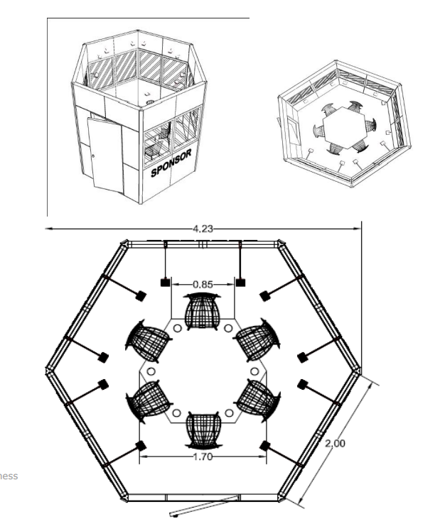
WHAT'S A BEE LAB?
STREAMLINING BUSINESS DECISION MAKING
BEE LAB SCREEN
BEE lab is basically emerging ways to discuss and schedule the various aspects of the business involving most serious to most common decisions with the help of every small fact surrounding you
There is a huge screen on one of the edges of the BEE LAB, which can be used as a display or a whiteboard, or a bee board. This multifunctional gadget allows the analyst to enhance his pitch to explain his research to the company's officials in charge
BEE LAB BOARDS
BEE LAB TABLE
BEE LAB consists of walls that have 2 bee boards on them. These give the analyst the to focus not only on a single part that can affect but also opens the door to relate these terms as a business needs to develop in terms of decisions
A table kept in the middle in the exact shape of the bee lab (i.e. hexagon) with a printed bee star on it makes the brainstorming sessions more interactive and useful this table is provided along with the BEE kit which is a bag that carries every small requirement that analyst can have during his research

Slide 7
COURSE CURRICULUM
Vocabulary Of Business Modelling
Introduction to Tools of Business Modelling
Pseudo Case Study
Green Business Visits
Article Reading And Brain Storming
Economics Of Business Modelling
Guest Lectures And Pitching Algorithm

Slide 8
MULTI-BUSINESS MODEL INNOVATION
Businesses must today adapt their business models more quickly, often, and broadly than in the past due to discontinuities and shocks, convergence, and fierce global competition. When possible viewed over, every angle in the business appears to be a completely distinct building. Therefore, to create decisions that are more and more effective, thought in every sense is necessary.

Slide 9
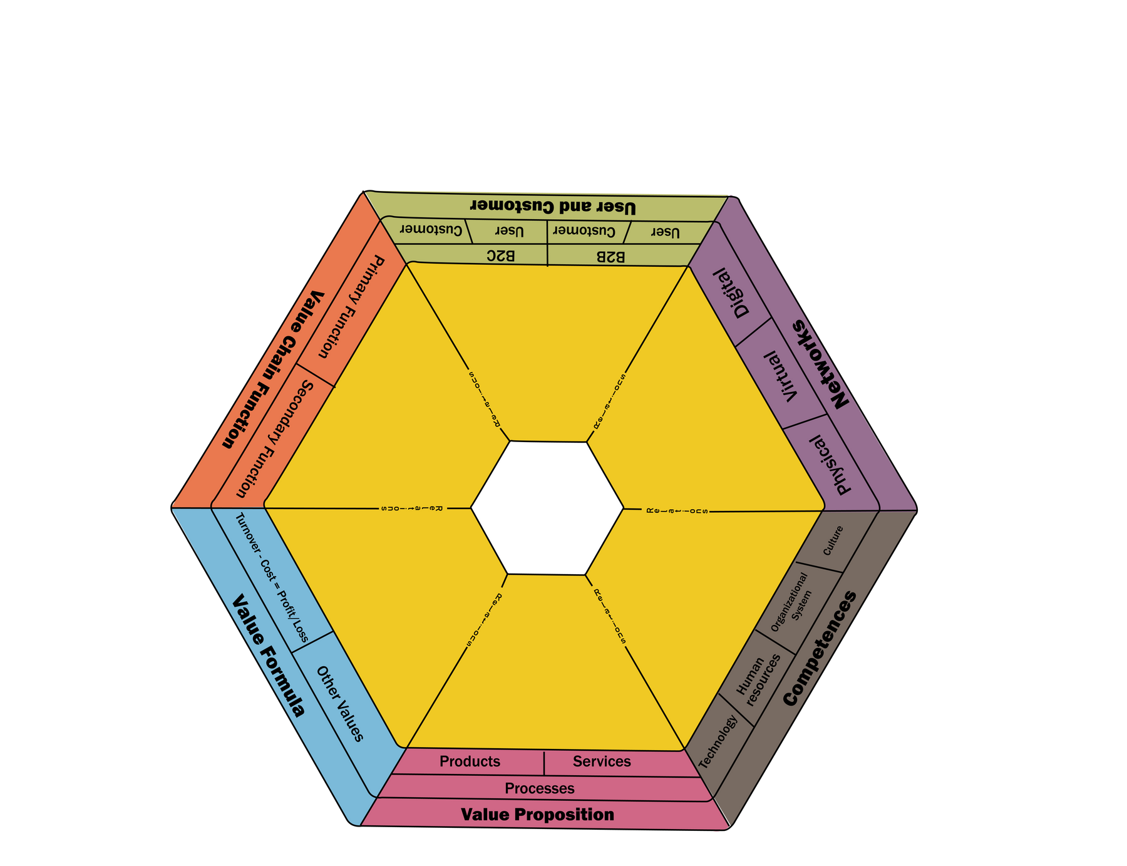
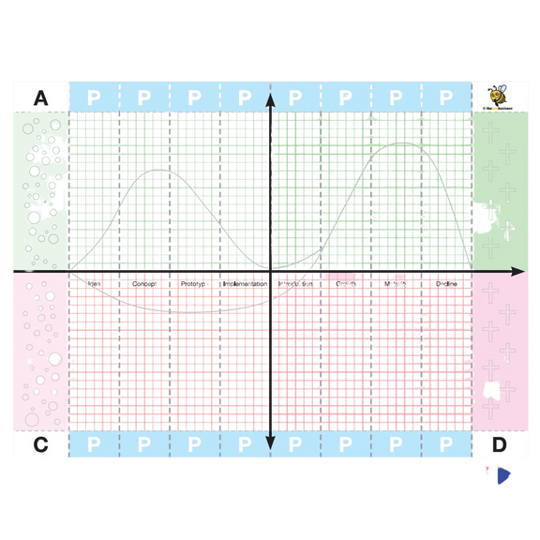
BUSINESS MODELLING TOOLS
BEE STAR
BEE BOARD
This tool is one of the most significant and advanced in its field, giving us an understanding of the overall structure of business modeling and allowing us to map relationships between all six directions that we study in depth during the course.
This tool represents the product life cycle but in an advanced way. Usually, a product life cycle is described after the product is injected into the market but here bee board allows us to track every minor change just after the ideation stage .....the colors define pre and post-market profits or losses where green defines profits while red defines losses

Slide 10
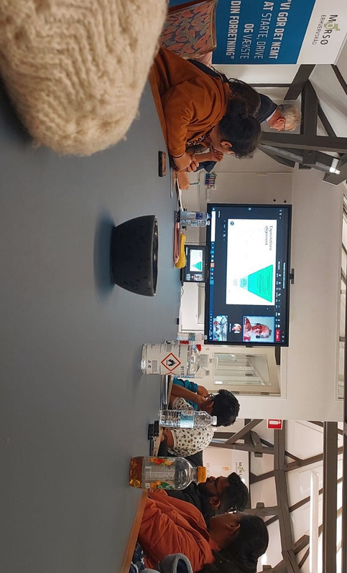
GREEN BUSINESS VISIT
Businesses must concentrate on the creation of a process that ensures the product is entirely constructed on principles that do not affect the ecosystem in order to achieve the highest level of sustainability and profitability. This visit enlightens us on the autonomous ecosystem construction of a collection of several unrelated and disparate industries that are working to advance and attain sustainability.

Slide 11
PROPOSED BRIDGE COURSES IN BM AT CGC AARHUS
01-day workshop for students, teachers, start-ups and industry corporates.
02-weeks workshop-detailed introduction to BM tools and its applications.
Selection of 25 students for 06 weeks training in Denmark.
Successful 06 weeks training in CGC Denmark.
Paid industry internships/employment in Danish or their associated industries globally.

Slide 12
EXPECTED OUTCOMES
Sustainable start-up.
Business Modelling (BM) exposure for better job.
Opportunity of global placements.
Ph.D. abroad.

Slide 13
INVESTMENTS
01-day workshop : INR 500/-
02-weeks workshop : INR 10,000/-
06 weeks training in CGC Denmark : INR 3,04,375/- (Note: Workshop cost will be adjusted)
Experiences at CGC Denmark:
https://www.youtube.com/watch?v=OBgyOkN1jwE
https://youtu.be/wGsSkapipJY

Slide 14
Thank You
For Your Attention

